Slide 1
Acceptability Judgements on
Contrastive Dialogues
Involving ellipsis
Master’s thesis
Supervised by
Prof. Dr. Michael Franke
Jun.-Prof. Dr. James Griffiths
Miriam Schiele
**DATUM***

Slide 2
Hypotheses
Study design
Results and revisiting hypotheses
Discussion
Background
The Influence of Metaphors
Contrastive Dialogues involving ellipsis

Slide 3
Background
A: Peter worked at the cinema FROM 6pm.
B: No, Peter worked at the cinema UNTIL 6pm.

Slide 4
Background

Slide 5
Hypotheses
Emphasis
Modality
Fragment type
Emphasis on contrasting words > dialogues lacking emphasis
Auditory stimuli > written stimuli
Lexical fragments > functional fragments

Slide 6
Study design: Factors
Emphasis
with
Modality
auditory
Fragment type
lexical
functional
without
written

Slide 7
Study design: Stimuli
with emphasis
A: Peter showed his ID to the POLICE OFFICER.
B: No, the BOUNCER.
A: Peter showed his ID to the police officer.
B: No, the bouncer.
without emphasis

Slide 8
Study design: Stimuli
with emphasis
A: Peter showed his ID to the POLICE OFFICER.
B: No, the BOUNCER.
A: Peter showed his ID to the police officer.
B: No, the bouncer.
without emphasis

Slide 9
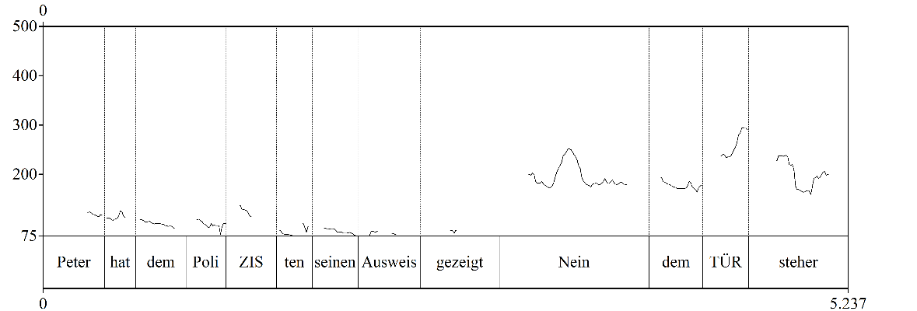
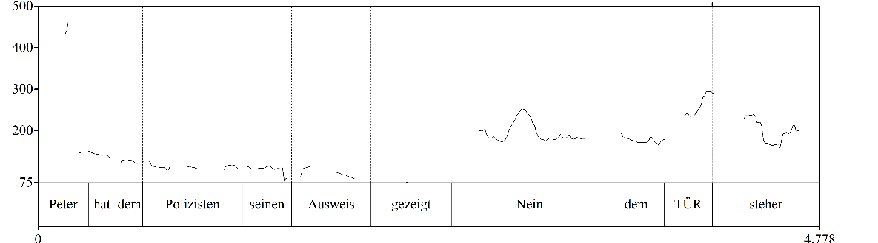
Study design: Stimuli
with emphasis
without emphasis

Slide 10
Study design: Stimuli
with emphasis
without emphasis

Slide 11
Study design: Stimuli
with emphasis
without emphasis

Slide 12
Study design: Stimuli
lexical
A: Peter showed his ID to the POLICE OFFICER.
B: No, the BOUNCER.
A: Peter worked at the cinema FROM 6pm.
B: No, UNTIL 6pm.
functional

Slide 13
Study design
modality
emphasis
fragment type
written
lexical
auditory
with emphasis
functional
without emphasis

Slide 14
Results

Slide 15
Discussion

Slide 16
Binding problem
multiple signals
onsets and offsets are disaligned
problem
pairing gestures with counterparts?

Slide 17
Binding problem
how can multiple signals carried by multiple articulators and on different modalities be combined rapidly to convey a coherent message?
similar input with more effort:
crane neck / sit up

Slide 18










Segregation Problem
How can we segregate movements?

Slide 19
Cross-level predictions
multiplex signals
multimodal gestalt
multiplex signals
multimodal gestalt
signals from articulators successively
X is followed by Y
lower level
bottom-up
meaning-bearing performances
formed by multiplex signals
higher level
top-down / bottom-up

Slide 20
Open questions
Ggfs weglassen
comprehension of signals?
temporal organization?
general or domain specific?
default mode?
cultural universals = innateness?

Slide 21
Thank you for listening!

Slide 22

Discussion

Slide 23
References
Chu, x

